Slide 1
JavaScript Type Inference
Class : Advanced Programming Language Principles
Name : Yogesh Dixit
ID : 010713963

Slide 2
Type Inference
Type Inference in a programming language means making a logical conclusion about the type of an expression
In statically typed languages like JAVA, C and Haskell type of an expression is known at compile time
Statically typed languages such as C and JAVA lack type inference, thus it is required that programmers declare the types when they write programs
Statically typed languages like Haskell uses type inferencing and it is not required for programmer to declare types while writing

Slide 3
Type Inference
In dynamically typed languages like JavaScript and Ruby type is associated with each value rather than expression and is known only at runtime
What does this actually mean?
In JavaScript as we all know, a variable at one time bound to a number may later be rebound to some different type of value such as string.

Slide 4
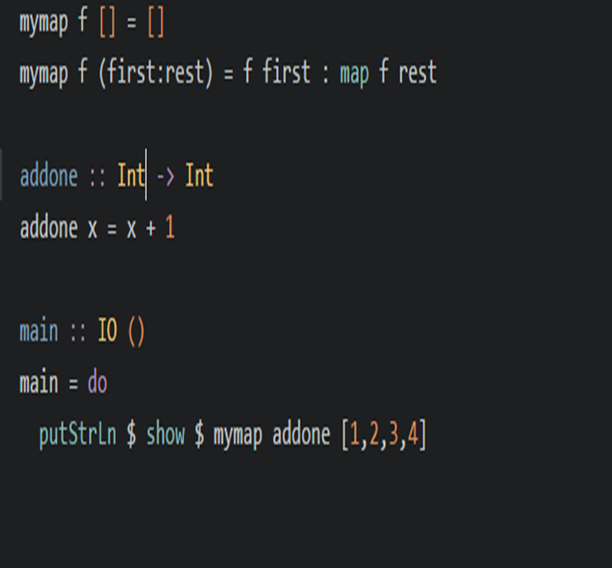
Type Inferencing Example (Haskell)
In the given example, let’s try to deduce how type inferencing is performed in Haskell
mymap is a function with two arguments (therefore of the form a -> b-> c)
Patterns [ ] and (first:rest) always match lists, so second argument is list [d] (list with members of type d)

Slide 5
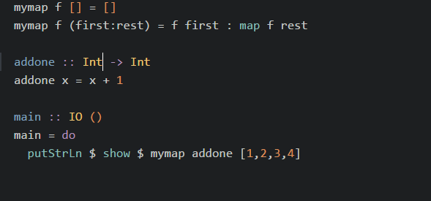
Type Inferencing Example (Haskell)
First argument f is applied to the “first” which must be of type d.
Thus f is a function of type d -> e
Finally mymap produces a list of whatever function f produces, thus [e]
Putting all the parts together we obtain signature of mymap would be mymap :: (a -> b) -> [d] -> [b]

Slide 6
Hindley-Milner type inference algorithm is well known algorithm for type inferencing in Haskell
Origin of this algorithm is from the works of Haskell Curry and Robert Feys for simply typed lambda calculus
Roger Hindley extended this work and Robert Milner provided an equivalent algorithm
In 1982, Luis Damas finally proved that Milner’s algorithm is complete and extended it to support systems with polymorphic references.
Thus Hindley-Milner algorithm is also known as Damas-Milner or Damas-Hindley-Milner algorithm.

Slide 7
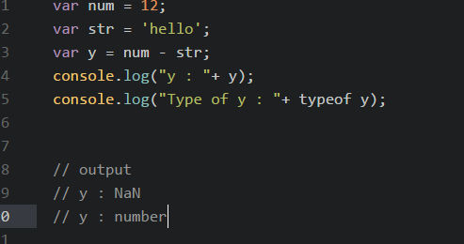
JavaScript without Type Inference
As there are no type annotations and no type inferencing in JavaScript
In the program as shown here we get some weird output which can lead runtime errors in more complex programs or situations
We can avoid such type errors by simply performing type inference on JS code

Slide 8
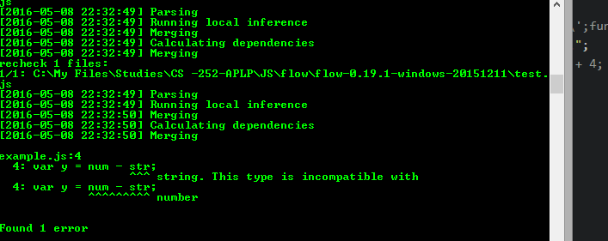
Type Inference in JavaScript using Flow JS
Flow is a static type checker designed to quickly find type errors in JavaScript applications
Flow relies heavily on Type Inference to find type errors
It precisely tracks the types of the variables as they flow through the program

Slide 9
Type Inferencing in JavaScript (Project)
Perform Type Inferencing on a given JavaScript code using AST
Construct AST using Reflect JS/ Esprima library
Once the AST is constructed walk through the AST to infer the types of the expressions using the types of the values involved in the expression
Use the range and location objects associated with every node of the AST to precisely determine the type errors and the location at which the type error is present

Slide 10
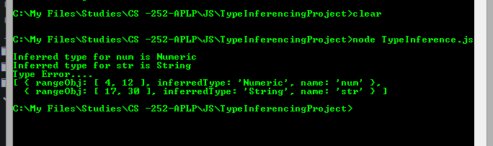
Type Inference in JavaScript (my utility program output example)

Slide 11
Benefits
Reduce or eliminate possible runtime type errors from the program.
Without using type annotations achieve the better results
More reliable code

Slide 12
Thank You

